Slide 1

Overview of Hydrological Monitoring

Slide 2
Hydrological Monitoring Systems
Applications and Technology Advances
How are the data used
New data collection technologies
New ways to make the data available
Notes:
This lecture is intended to provide an introduction to the operation of hydrologic monitoring networks in the U.S. and how the data are collected, managed, and disseminated for use.

Slide 3
Effective management of water resources depends on accurate and timely information:
Short term operating decisions
Require real-time data
Long term management decisions
Require long-term data
Notes:
Short term decision – How much water to release from a reservoir to optimize power production while avoiding flooding.
These decisions require real-time data.
Long-term decision – What is an estimate of the mean monthly flow for a river where a new dam is planned.
These decisions require long-term data from many sites.

Slide 4
Short term decisions
Flood warning for emergency management
Reservoir operation (fill and release)
Drought response
Diversions from rivers for irrigation
Public health warnings

Slide 5
Long term decisions
Flood risk assessment
Hydropower development
Water availability (feasibility studies)
- Public water supplies
- Agricultural development
- Industrial requirements
Maintaining water quality to protect beneficial use
Notes:
These are examples of how long-term hydrologic data are useful in making resource management decisions.

Slide 6
Hydrological Information Systems
The benefits are many
All of these questions and issues can be addressed by a well-designed Hydrological Information System.
The backbone of this system is hydrological monitoring
Build quality into the monitoring network right from the beginning.
It may require patience and a slower start but you’ll never regret it in the end!
Notes:
These are examples of how long-term hydrologic data are useful in making resource management decisions.

Slide 7
Advances in Hydrological
Monitoring Networks
How are the data useful
New data collection technologies
New ways to make the data available
Notes:
Next I’d like to talk about new technologies that have improved our ability to collect hydrologic data.

Slide 8
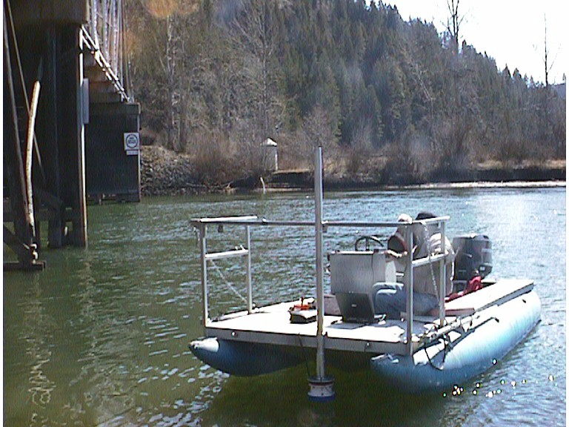
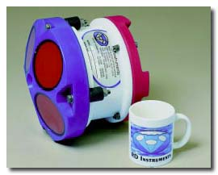
Discharge measurement
using ADCP
Notes:
Acoustic instrumentation for use in measuring oceangraphic currents has been around for 15-20 years but has been applied for measuring velocity and discharge in the riverine environment in recent years and the range of applicability is continually being expanded. This is a picture of a acoustic Doppler current profiler or ADCP used for making discharge measurements in medium and large rivers. This particular instrument is shown mounted on a boat with a cable connection to a laptop computer.

Slide 9
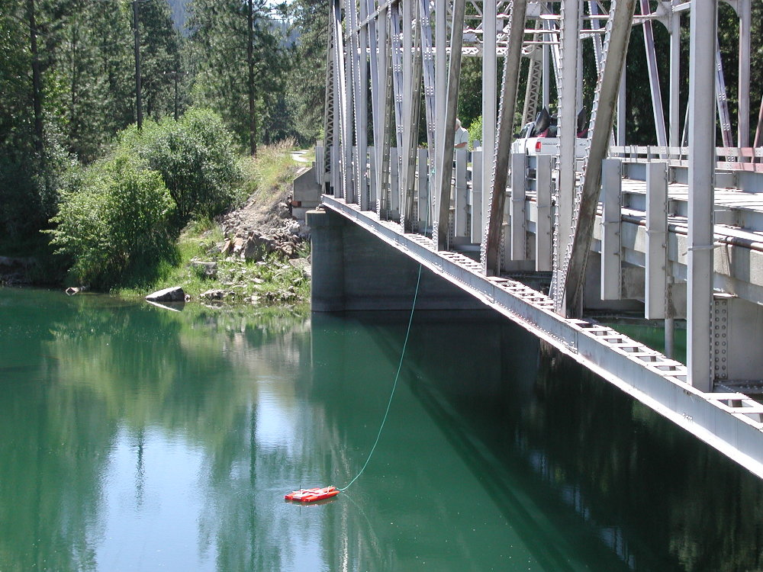
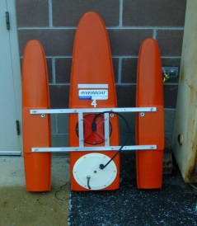
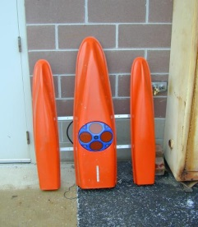
Discharge measurement using
tethered ADCP and Riverboat
ADCP connected to laptop
computer using radio modem
Riverboat with ADCP
Notes:
This is an ADCP being deployed in a towboat for making discharge measurements from a bridge. The data from the ADCP is sent to a laptop computer on the bank by means of a radio modem.

Slide 10
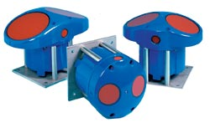
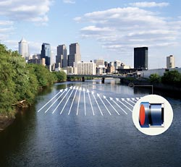
Acoustic Doppler Velocity Meters
(ADVM)
ADVM’s are installed in rivers for continuous velocity and flow measurements
Notes:
Other applications of acoustic technology include acoustic Doppler velocity meters or ADVM’s as shown in this picture. These instruments are fixed-mounted in a river and used to continuously measure an index velocity in the channel. The index velocity is correlated with the mean channel velocity. Once a rating has been developed between index and mean channel velocity data from the ADVM can be used to provide continuous discharge in a river. This approach is useful in backwater reaches where traditional stage-discharge ratings don’t apply.

Slide 11
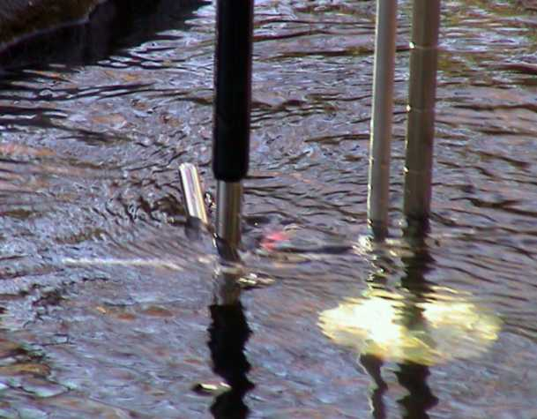
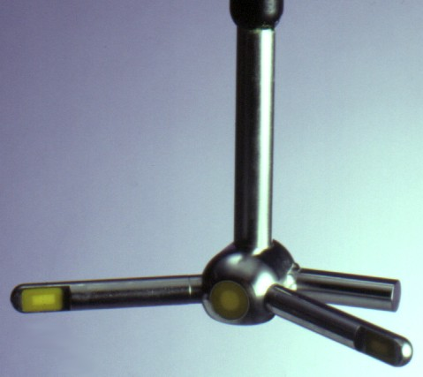
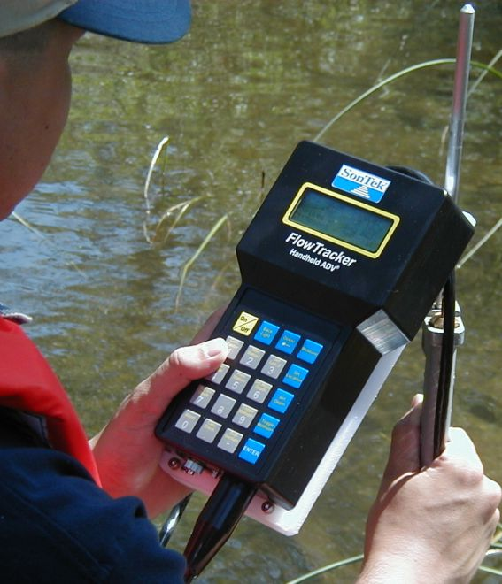
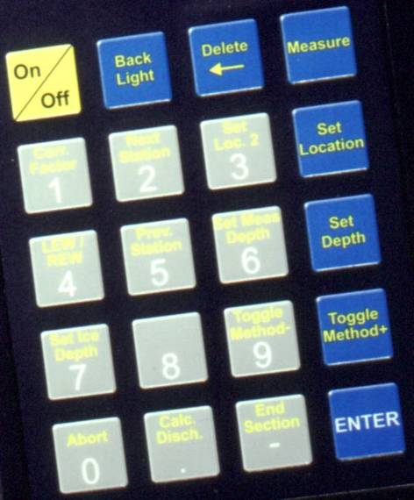
SonTek FlowTracker
  Point-velocity meter (not profiler)
  Especially useful for low-velocity measurements
  No bottom tracking
Notes:
Another acoustic instrument is the handheld acoustic velocity meter or AVM shown here. This instrument is used to make very precise measurements of velocity at a point in a stream or canal. They are also used in laboratory experiments for measuring velocity. These instruments are designed to measure either 2 or 3 dimensional velocity at a point and are useful for making discharge measurements in a small stream or measuring turbulence or other flow characteristics in a laboratory flume.

Slide 12
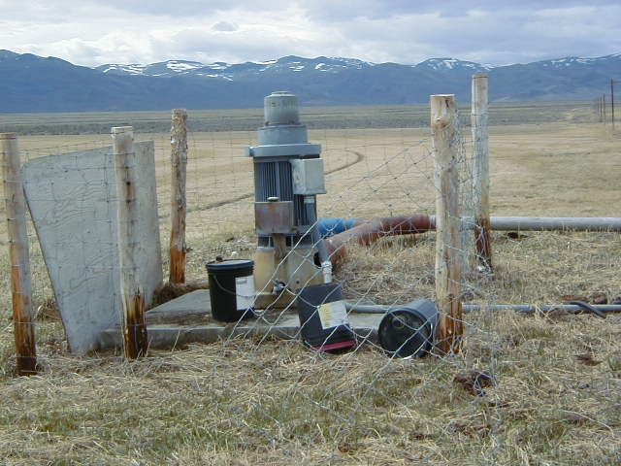
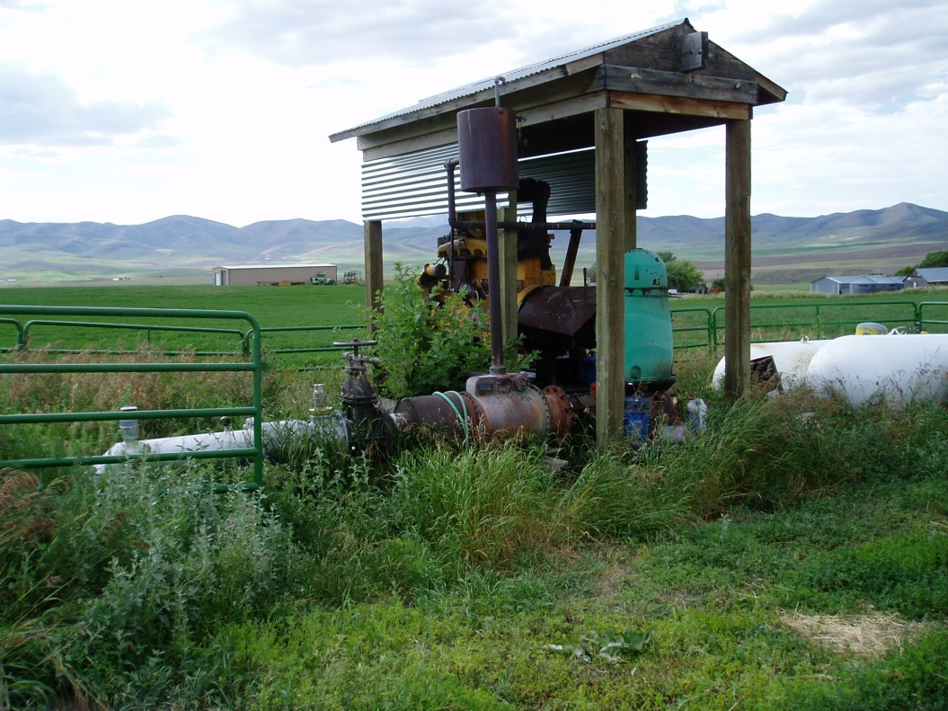
Ground-Water Monitoring
Needed to protect aquifers from overdrafting.
GW models provide useful management tools but require good data to be accurate.

Slide 13
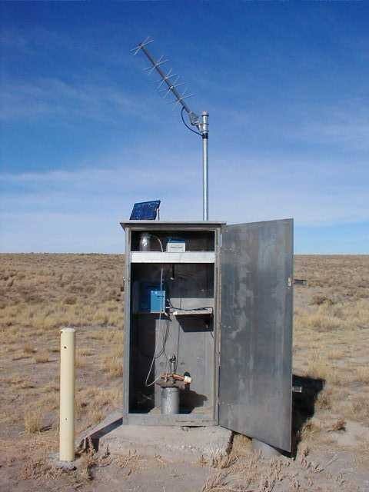
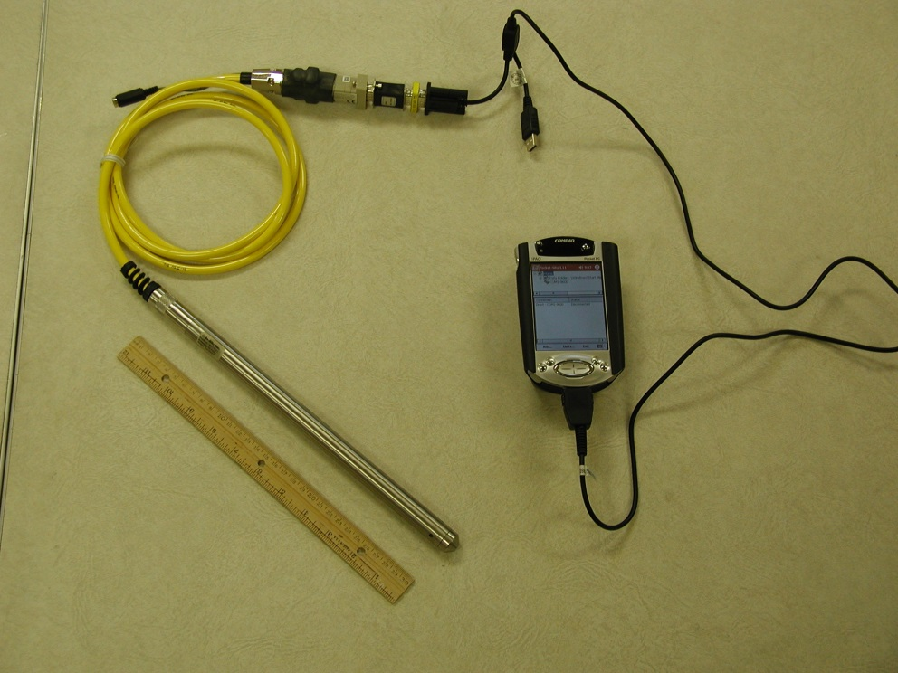
Ground-Water Monitoring
Real-time data are becoming more important.
Equipment is improving.

Slide 14
Water Quality Monitoring
Temperature
pH
Conductivity
Dissolved oxygen
Turbidity
The common parameters are easily monitored
Suspended Sediment
Salinity
Fecal Coliform Bacteria
Phosphorus
Nitrogen
More difficult parameters can be monitored using surrogates that are easier to monitor
Notes:
Advances in water quality sensors have also changed the way in which we monitor water quality parameters. Either measuring these constituents directly or by means of surrogates has enabled us to monitor and relay QW data in real time, which has proved useful in making better resource management decisions.

Slide 15
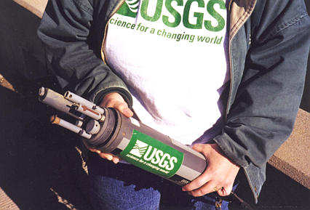
New tools are available -
In-stream continuous monitors
pH
Water Temperature
Dissolved Oxygen
Specific Conductance
Acoustic backscatter
Turbidity
Fluorescence
Notes:
This is an example of a multi-parameter sensor that is deployed in the stream for monitoring a variety of QW parameters.

Slide 16
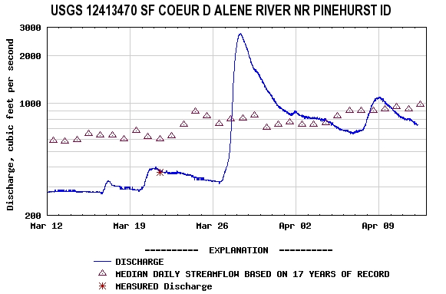
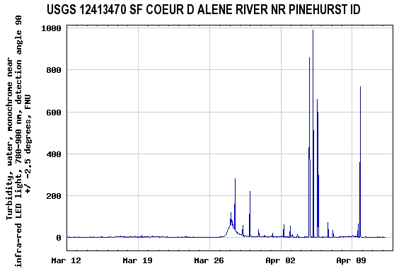
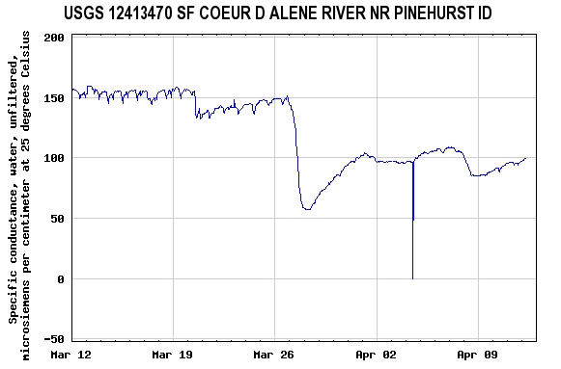
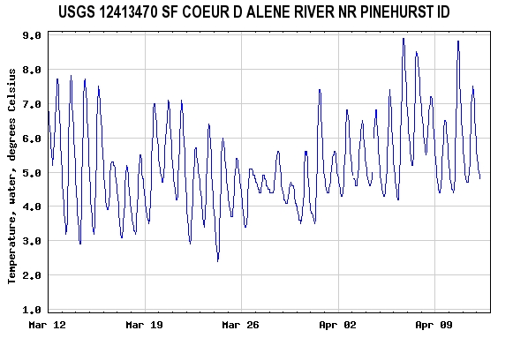
Real-time discharge and water-quality data
Notes:
Data from these sensors are transmitted in real time along with discharge data and posted on the USGS website for access by anyone, anytime.

Slide 17
Acoustic Doppler Velocity Meters
(ADVM)
ADVM’s can also be used for continuous monitoring of suspended sediment
The same instrument gives you both flow and sediment data.
Notes:
Earlier I mentioned the use of ADVM’s for monitoring river velocities in backwater environments. These instruments are also being used to monitoring suspended sediment concentration.

Slide 18
Acoustic Backscatter (ABS) can be correlated with sediment concentration in some cases.
Notes:
Acoustic backscatter is a signal that is measured by the the ADCP and ADVM. It has been found to correlate well with fine-grain sediment concentration. In this slide you can see how backscatter intensity is greater near the center of the channel and near the bed, which is where you would expect the higher sediment concentrations to be as well.

Slide 19
Advances in Hydrological
Monitoring Networks
How are the data useful
New data collection technologies
New ways to make the data available and useful
Notes:
Finally, I’d like to talk a little about new approaches for making the hydrologic data available.

Slide 20
Real-Time Hydrologic Data
Data available for rapid decisions
Improves quality and completeness of data for long-term uses
Increases public awareness of the resource and issues
Notes:
In the past we often had to wait days, weeks, months, or even years before we had access to hydrologic data that had been collected. Widespread use of telemetry devices has allowed us to have the same data in real or nearly real time. This has had a big impact on how the data can be used.

Slide 21
Real-time streamflow data
Waterwatch
water.usgs.gov/waterwatch
Notes:
In the US for example many of our gages have been instrumented with telemetry devices. In the USGS alone more than 5000 or our 7100 gages have this capability. The data are then posted regularly on the internet at the following website.

Slide 22
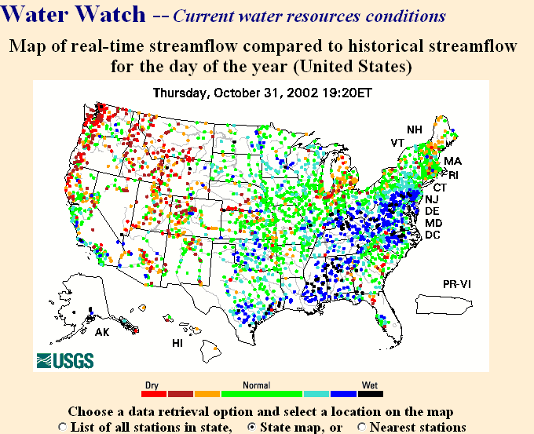
Notes:
This website allows you to see at a glance what is the status of streamflows throughout your region or the entire country. In this case we see that in the western US dry conditions exist whereas normal conditions exist in the center of the country, and wet conditions exist in the east.
Now if you’re particularly interested in a certain state you can click on it and bring up a more detailed map.

Slide 23
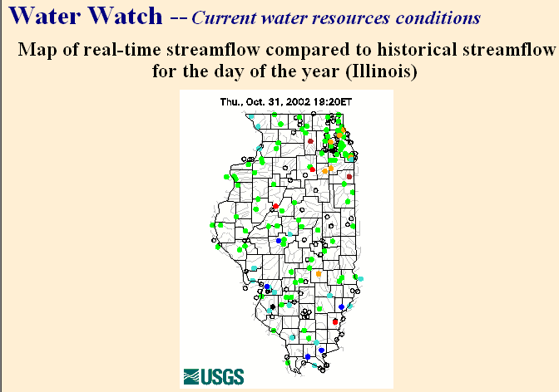
Water.usgs.gov/waterwatch
Notes:
Then if you are interested in real-time data for a specific gaging station you can click on that site and bring up the most recent data available.

Slide 24
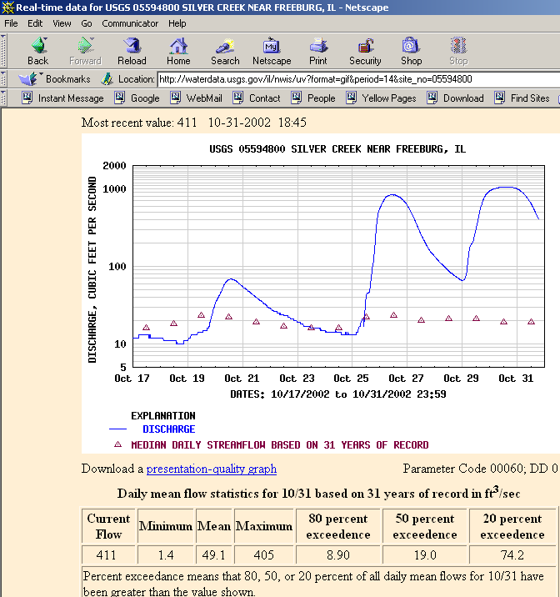
Notes:
The data are no more than four hours old and often much more recent than that. This plot shows the current river discharge as well as some statistical information based on long-term hydrologic records. This allows you to get a feeling of how the current conditions compare with long-term averages.

Slide 25
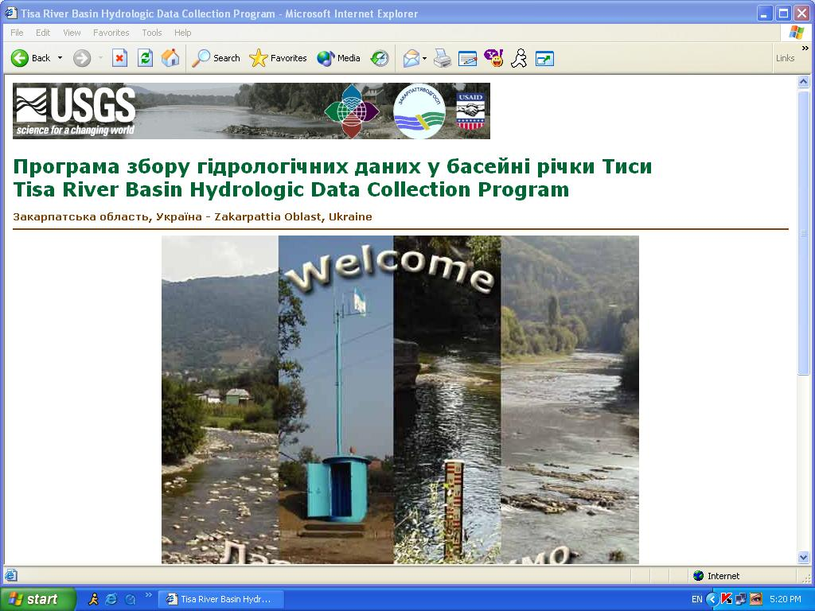
Hydrological Data Network in Ukraine

Slide 26
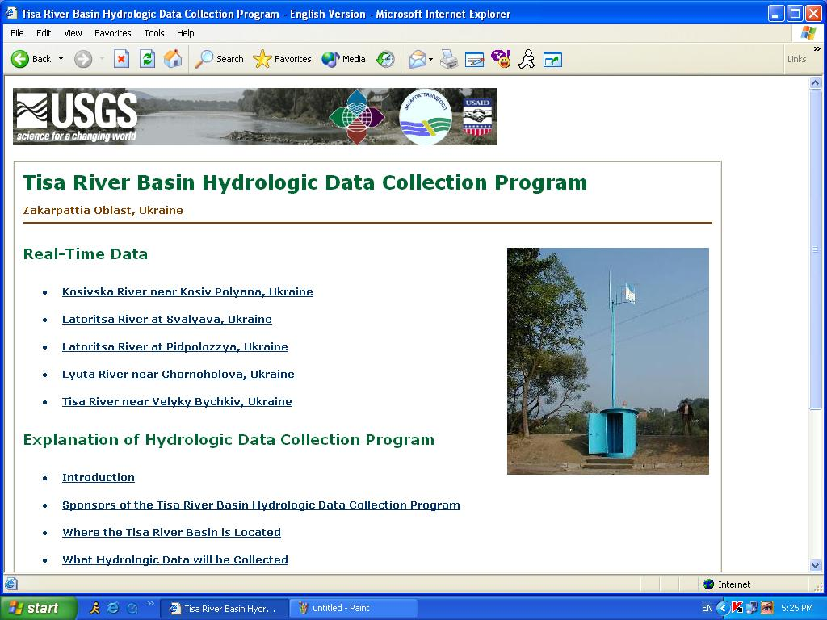
Data Relay and Web Posting

Slide 27
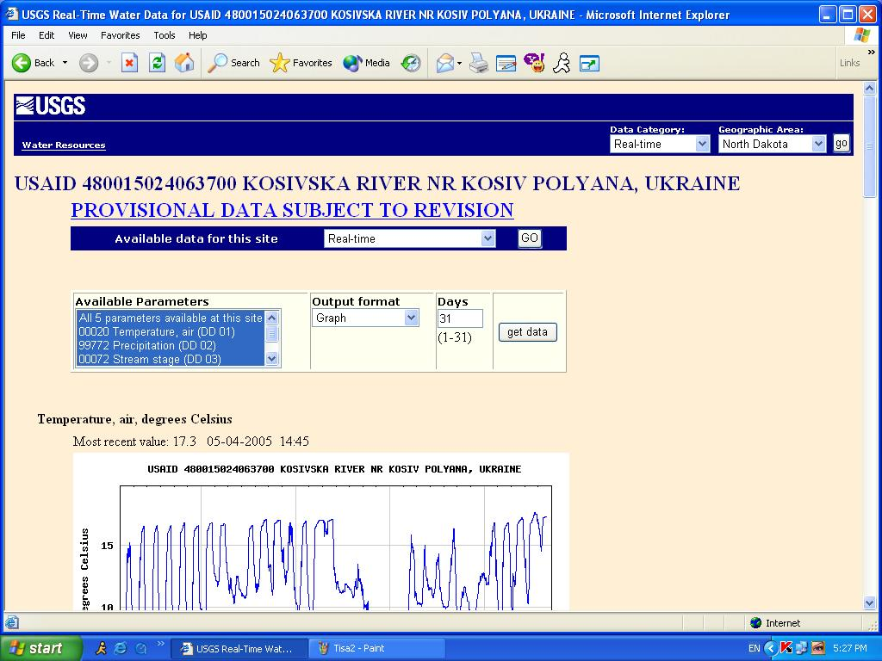
Kosivska River

Slide 28
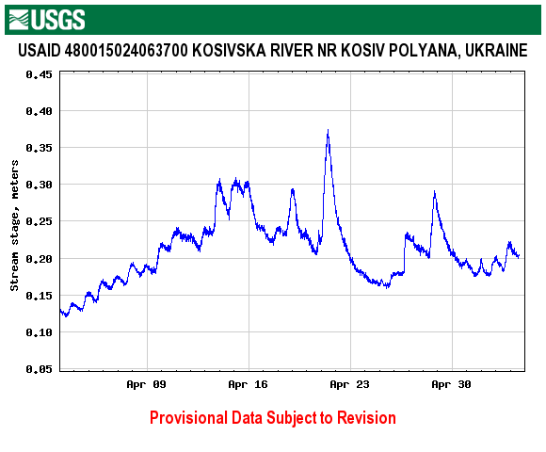
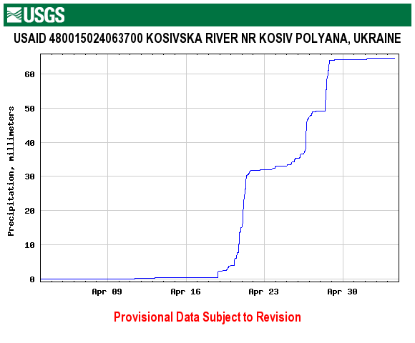
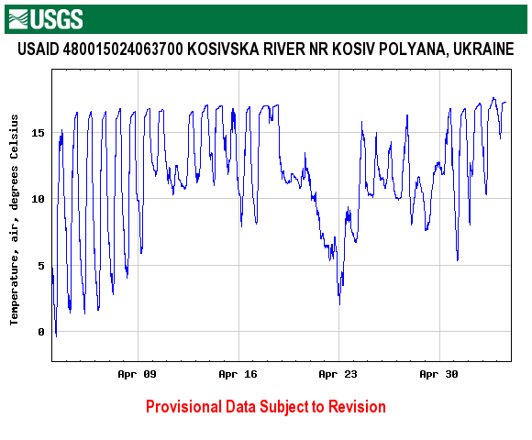
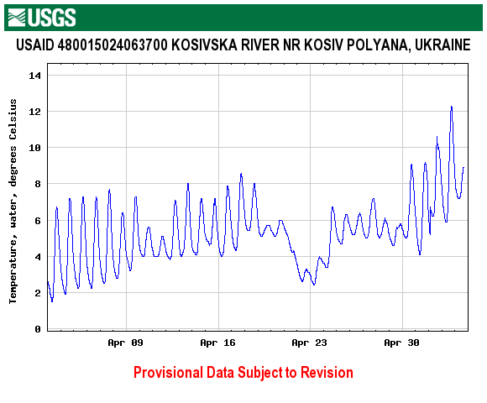
Kosivska River
Real-time Data (stage, temp, precip)

Slide 29
Long-term Hydrologic Data
Water resources assessments
Hydropower
Irrigation
Public supply
Flood risk assessments
Water quality trends assessments
Notes:
In the past we often had to wait days, weeks, months, or even years before we had access to hydrologic data that had been collected. Widespread use of telemetry devices has allowed us to have the same data in real or nearly real time. This has had a big impact on how the data can be used.

Slide 30
StreamStats
GIS-based Watershed Analysis
Welcome to StreamStats
Notes:
StreamStats in another powerful GIS tool based on the ARC Interactive Map Server or IMS. This tool simplifies the task of delineating watershed boundaries, calculating basin characteristics, and estimating flow statistics at ungaged sites. What would have taken hours and days in the past can now be done in a matter of minutes.
The user interactively selects a location on a stream and with the click of the mouse is able to generate a basin boundary and a shape file for use in other applications. The software then calculates a number of basin characteristics such as drainage area, mean elevation, mean annual precipitation, aspect, and slope. These parameters are then input into previously derived regional regression equations, which are used to generate estimates of a variety of flow statistics.

Slide 31
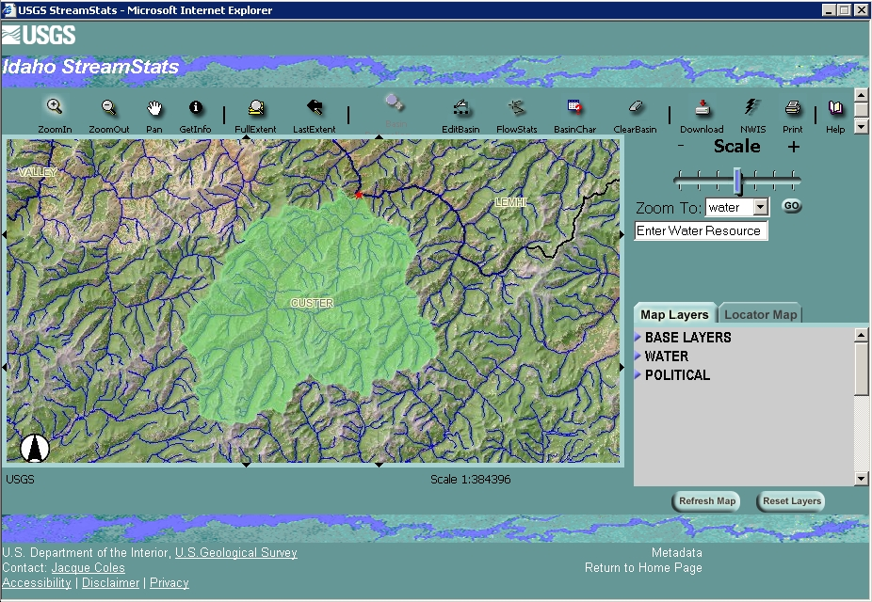
StreamStats
GIS-based Watershed Analysis
Notes:
StreamStats in another powerful GIS tool based on the ARC Interactive Map Server or IMS. This tool simplifies the task of delineating watershed boundaries, calculating basin characteristics, and estimating flow statistics at ungaged sites. What would have taken hours and days in the past can now be done in a matter of minutes.
The user interactively selects a location on a stream and with the click of the mouse is able to generate a basin boundary and a shape file for use in other applications. The software then calculates a number of basin characteristics such as drainage area, mean elevation, mean annual precipitation, aspect, and slope. These parameters are then input into previously derived regional regression equations, which are used to generate estimates of a variety of flow statistics.

Slide 32
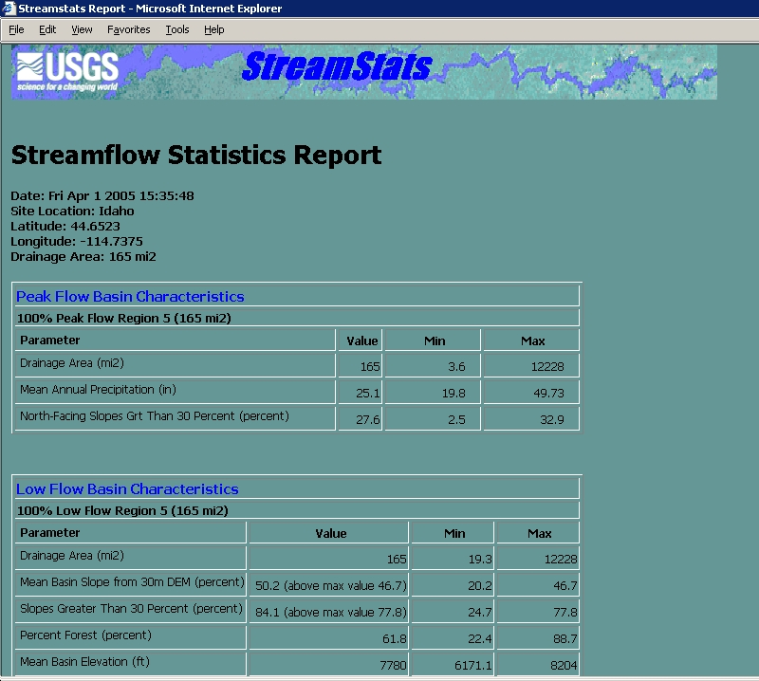
StreamStats
GIS-based Watershed Analysis
Notes:
This is an example of the report that is generated by StreamStats showing some of the basin characteristics that were derived for the selected site.

Slide 33
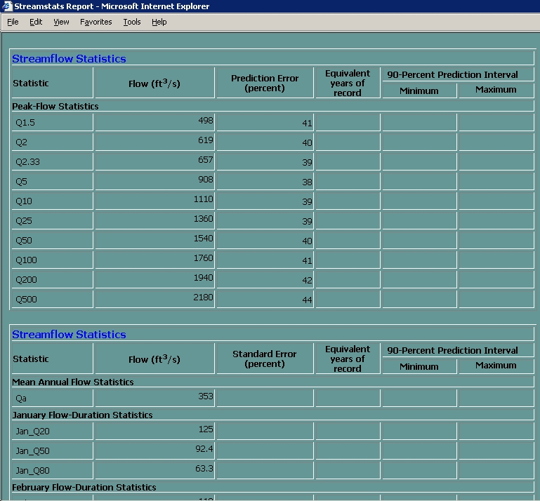
StreamStats
GIS-based Watershed Analysis
Notes:
This is a continuation of the report in which a variety of flow statistics are provided.
This information is very useful for designing structures such as bridges and culverts over streams where no streamflow records are available. StreamStats is also useful in the development of input data sets for watershed models needed to forecast inflows to reservoirs.

Slide 34
Overview of Hydrological Monitoring Systems
These are just some examples to help you understand the value of your Hydrological Monitoring System.
It’s important that you begin to think of new ways to obtain, manage, and use your data for the benefit of your city, state, and all of India!
The possibilities are limitless. It just takes people with imagination and a good attitude to make it happen!
Notes:
In the past we often had to wait days, weeks, months, or even years before we had access to hydrologic data that had been collected. Widespread use of telemetry devices has allowed us to have the same data in real or nearly real time. This has had a big impact on how the data can be used.

Slide 35
Questions or Comments?

